Slide 1
AutoGradeMI Project Proposal
Presented by:
Eric Zheng
Yihang Lin
Bokai Shang
Yunchuan Zhou
Nov 5, 2024

Slide 2




Introduction
~400 million IELTS takers per year
Essay marking is subjective
Practicing is expensive!
$360 test fee, ~$50 per hour tutoring[1]
Score
&
Comment
Essay
Notes:
Let me first briefly introduce our project.
Our project is aimed to produce a score and comment given an essay in standardized language tests. ‘
Since IELTS is the most commonly accepted English exam in Canada, our team will focus on the IELTS exam writing part
Why do we select this task? there are about 400 million test takers for IELTS each year. And essay marking is a subjective process. Many students believed they received a unfair score.
Practicing is also expensive. So we want to build a system to give fair score and feedback for students to prepare for exam.
[1]https://englishtests.ca/pricing/#:~:text=IELTS%20Test%20%24359.99%3B%20IELTS%20Tutoring%20%28per,hour%29%20%2449.50%3B%20IELTS%20Prep%20Course%20%24149.99.

Slide 3




Datasets, Data Collection, and Processing
Filtering out task 1 samples
Removal of Duplicates and Undefined Data
Label Standarization
Data Distribution Analysis
Sampling/data augmentation (if applicable)
Notes:
Kaggle and HuggingFace are our main sources of data, where the design team has found three collections of high-quality IELTS essays from the past, where each sample is an essay-score pair. Despite the conveniences, the samples from different collections are organized and labeled differently, which require extra cleaning procedures.
The processing procedure begins with filtering, removing those samples that belong to the first task through matching regular expressions and removing those that are explicitly labeled under task 1. Then, the remaining samples will be merged together, where exact replicas and undefined samples (i.e. unmeaningful or ill-structured data) will be removed. The scores of each essay will then be standardized to an agreed format.

Slide 4
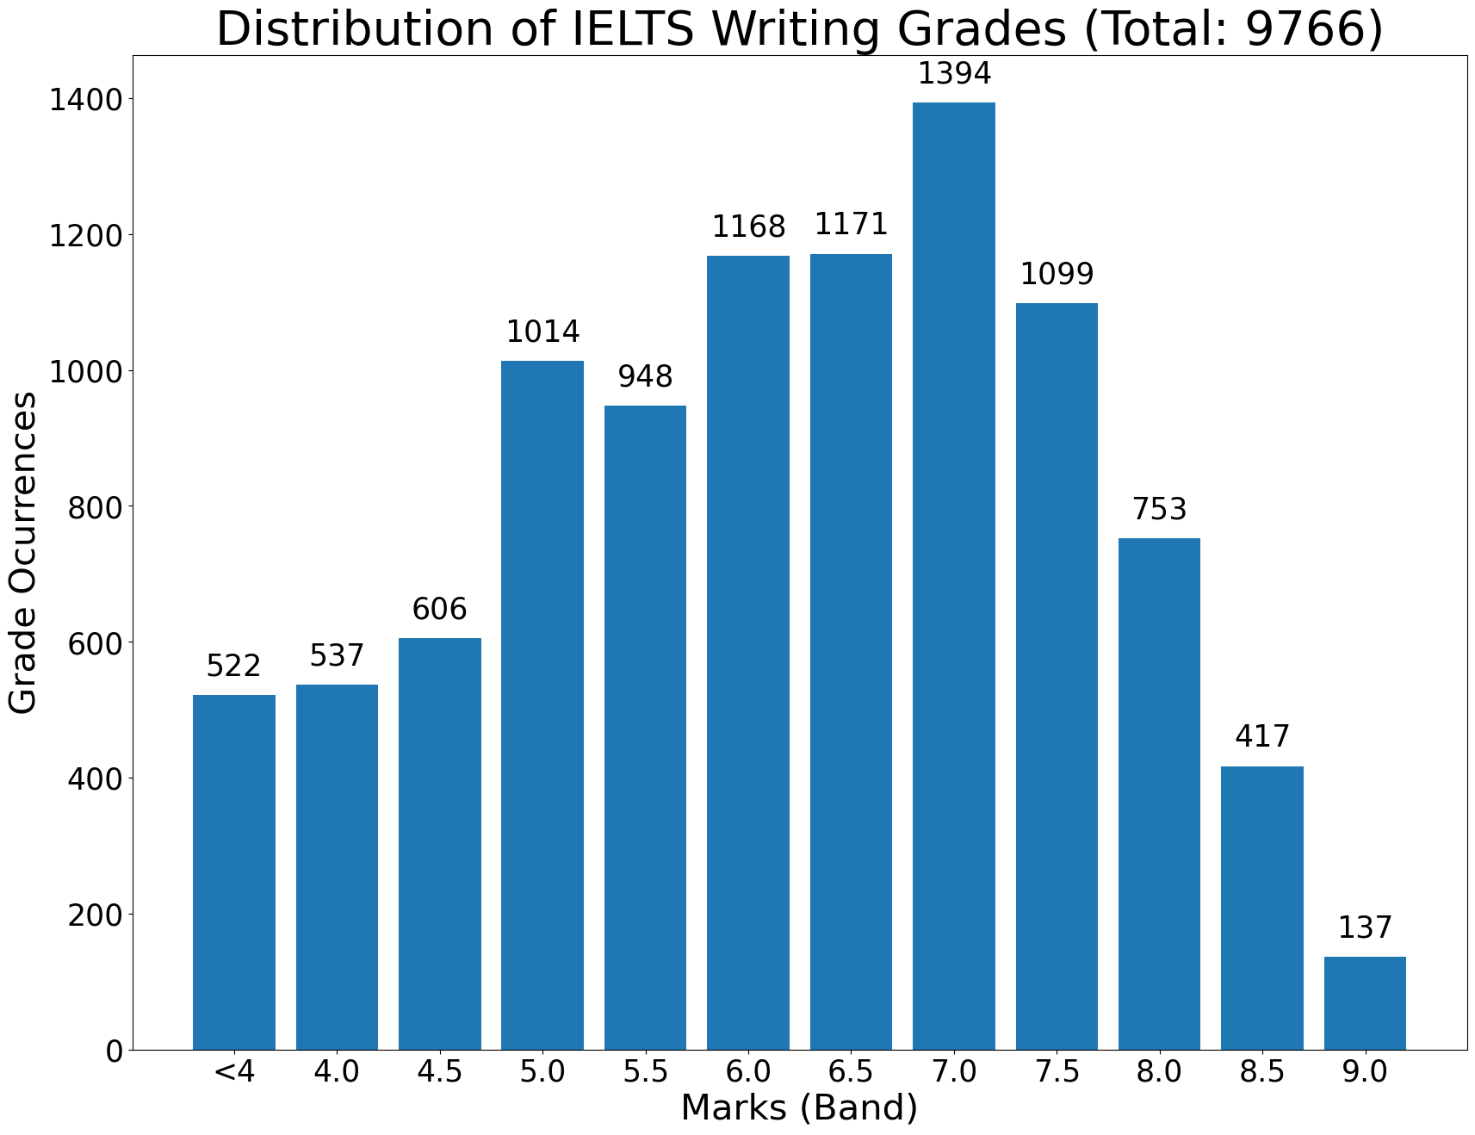
Datasets, Data Collection, and Processing
Data Distribution
Our Cleaned Post-Processed Dataset
Notes:
The last step of data processing requires an evaluation regarding the distribution of essays based on their scores. If the dataset is unbalanced, then sampling or data augmentation (i.e. synonym replacement) techniques will be performed to assure the access of a balanced, standardized, and centralized dataset that is ready to be used for training, fine-tuning, testing, and other application scenarios.

Slide 5
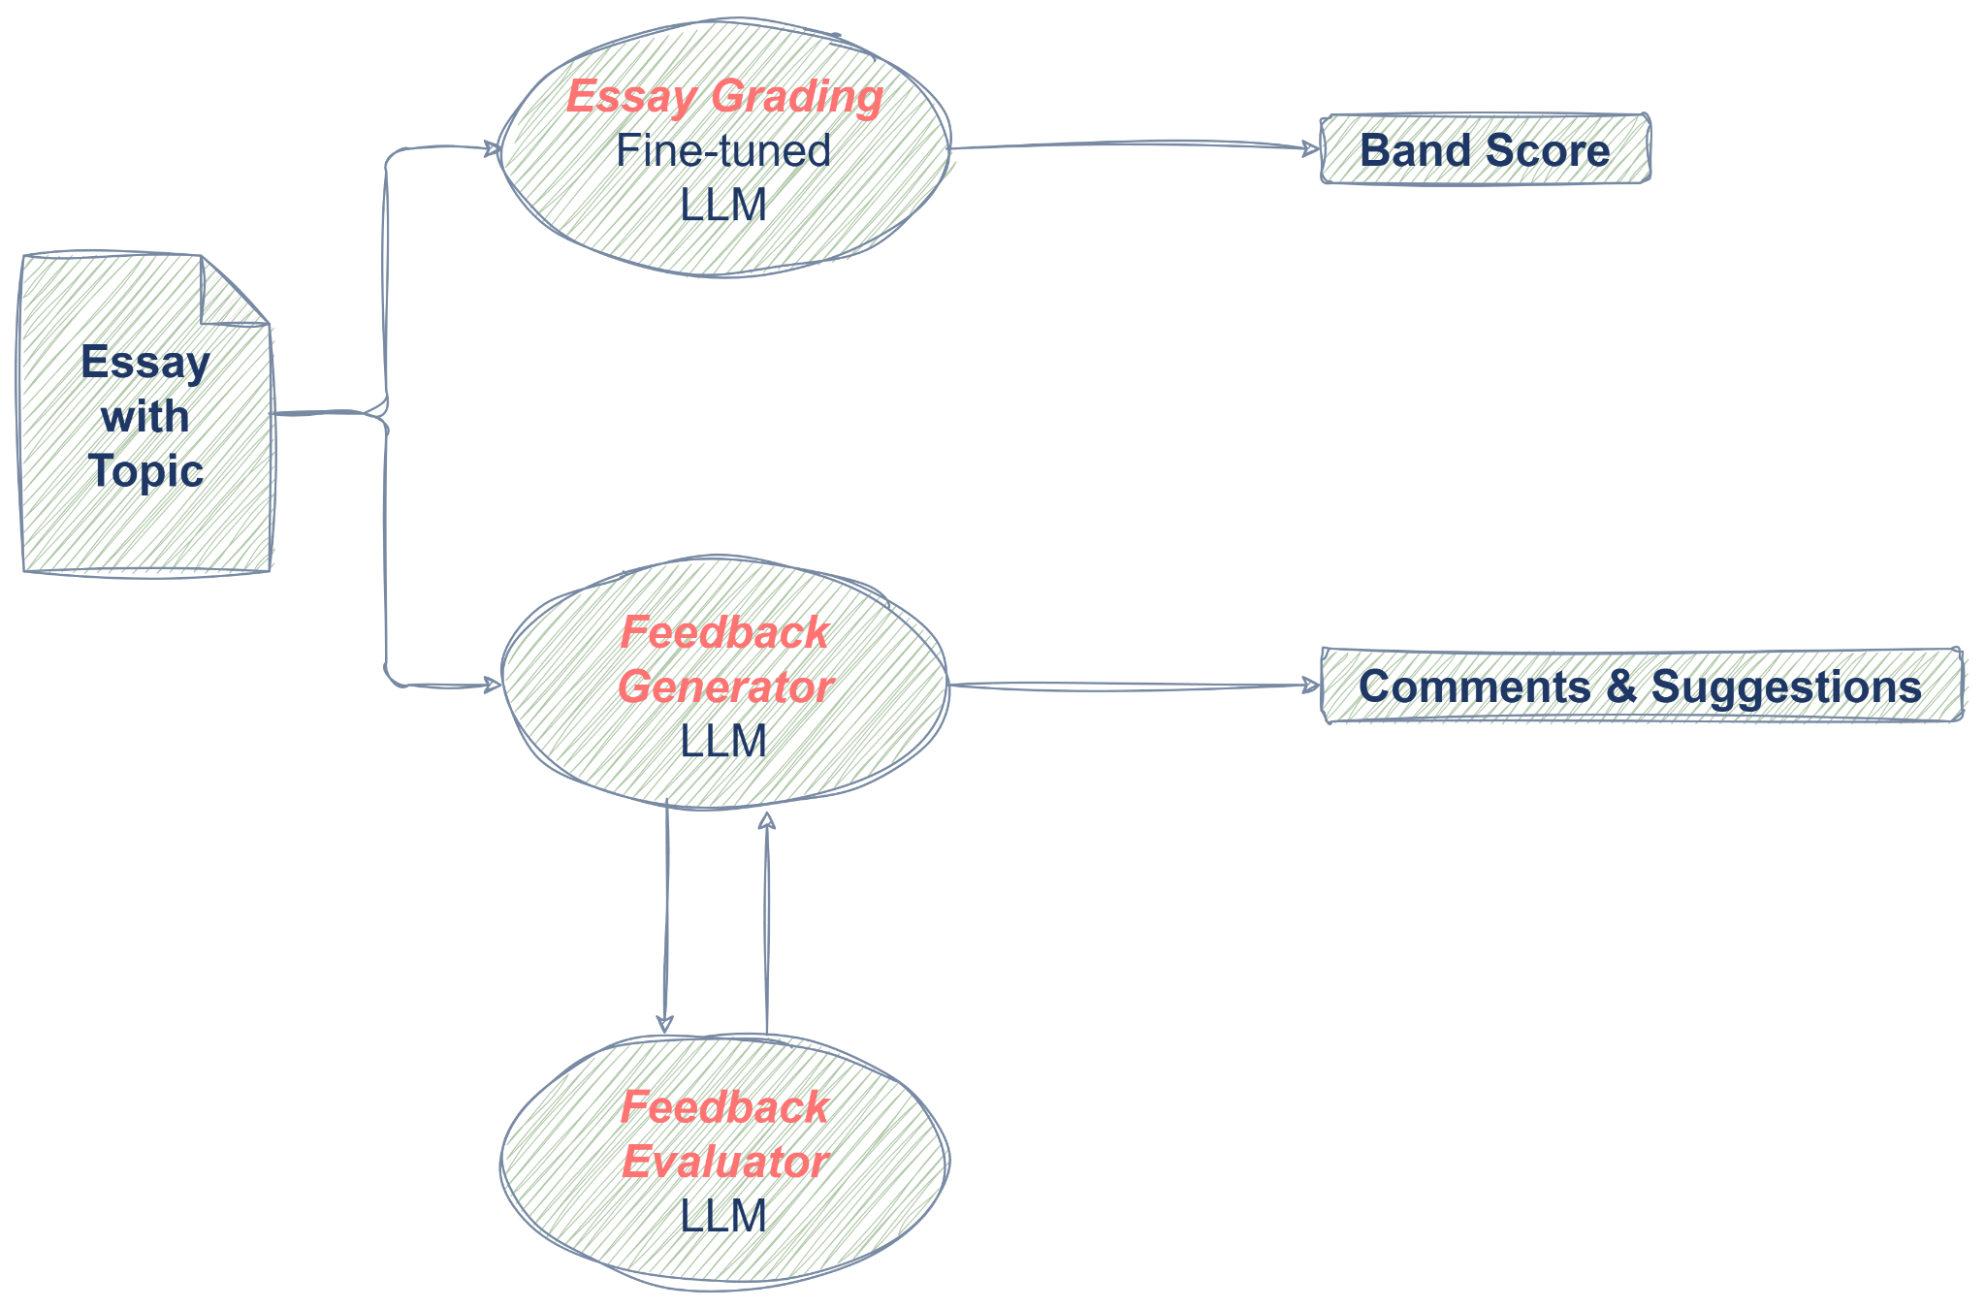
System Diagram
Notes:
Our project is a multi-agent system for evaluating IELTS essays, there are three specialized LLM agents.
First, the Essay Grading Agent is a fine-tuned LLM trained on IELTS essay samples to predict band scores based on key quality indicators. This agent generates a score that closely aligns with IELTS standards.
Next, two collaborative agents handle feedback: the Feedback Generator and the Feedback Evaluator. The generator uses prompt engineering to analyze specific areas of the essay, crafting detailed comments and improvement suggestions. The evaluator reviews this feedback to ensure it is accurate, relevant, and consistent.
The workflow begins with inputting the essay and topic into the Grading Agent and Feedback Generator in parallel. The Grading Agent predicts the score, while the generator provides suggestions that are supervised by the evaluator.
This system offers a comprehensive approach to IELTS essay evaluation, providing both scores and actionable feedback.

Slide 6
Risks and Mitigation Strategies
Risk 1: High computational demand for fine-tuning GPT-4.
Mitigation: Use Low-Rank Adaptation (LoRA) to reduce trainable parameters
Risk 2: Potential misalignment between agents.
Mitigation: Refine prompts and apply IELTS rubric for consistency.
Notes:
Let me discuss the risks and mitigation strategies for this project.
Fine-tuning a large language model like GPT-4 is highly computationally intensive. Given the model’s large size, there’s a high risk of running out of computational resources. To address this, we plan to use the method of LoRA to reduce the number of trainable parameters, making fine-tuning more feasible with our available resource.
In addition, The system has two agents to generate feedback for users. While each agent can be fine-tuned separately, they may still produce inconsistent comments or suggestions. To address this, we’ll improve our prompt design with more refined prompts and use the official IELTS evaluation rubric to keep their feedback consistent and aligned with assessment standards.

Slide 7
Plan
Data collection and processing
Grader agent development
Baseline model development
Feedback generation agent development
Feedback evaluation agent development
Feedback system integration and potential debugging
UI development
Final deliverables
Complete at Progress Report
Notes:
Here is a list of tasks
we plan to have datas prepared, and all the three agents and the baseline model working individually in progress report
For the later work, we have them work together and build a UI

Slide 8
Thanks for watching

